Slide 1
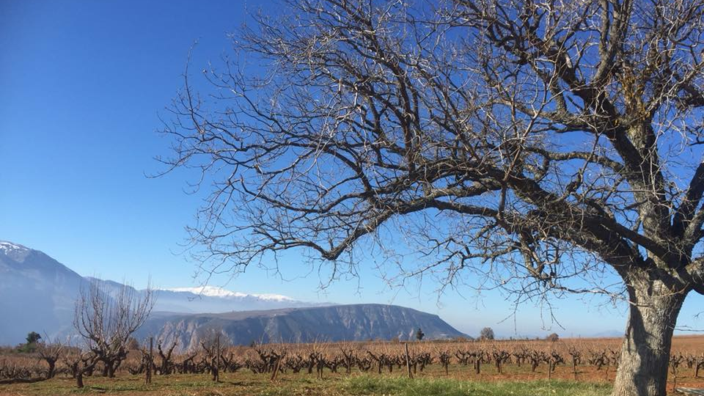

Slide 2
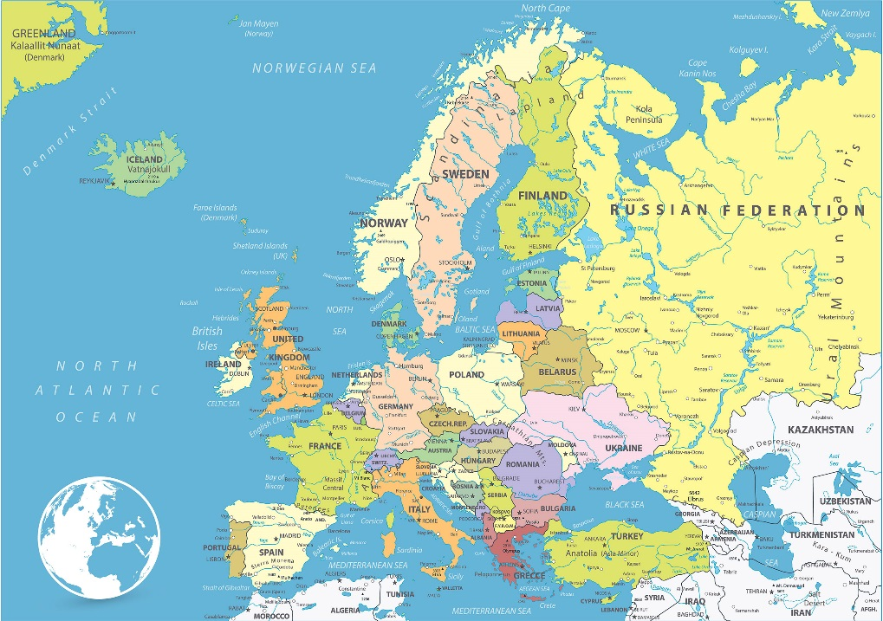
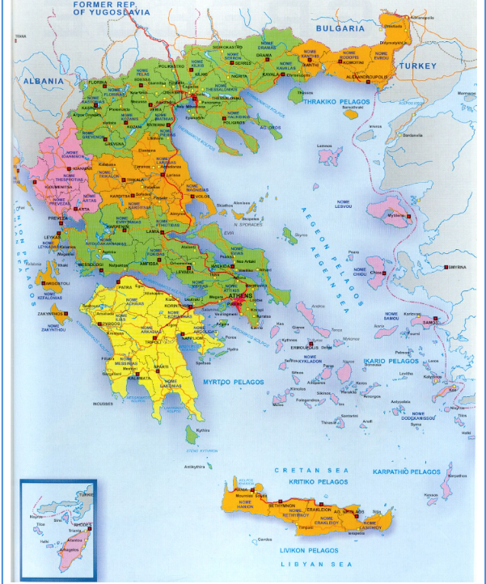
Where we are
Egio,
Peloponnese,
Greece

Slide 3
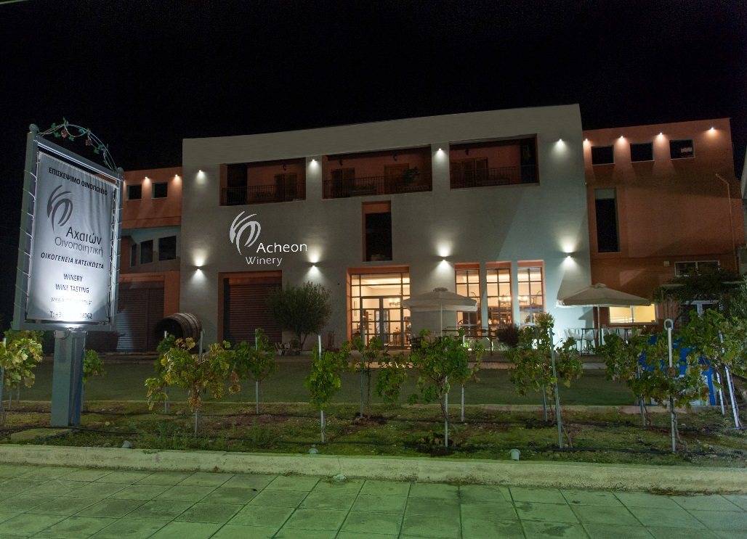
Presentation of the company
founded in 1946
based at Aigio Achaia
long family tradition
third generation winemakers

Slide 4
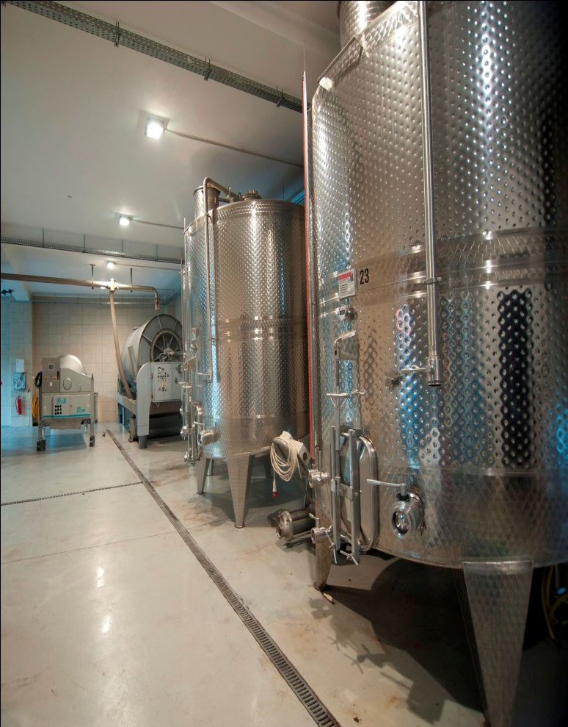
Services-Production
modern premises and state-of-the-art equipment
implementation of the food safety management system ISO 22000
production capacity 550 TN

Slide 5
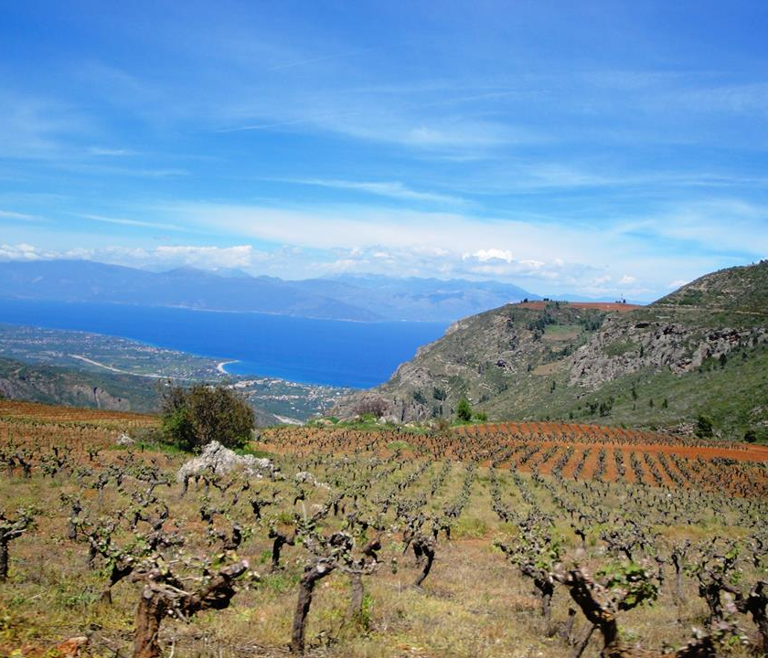
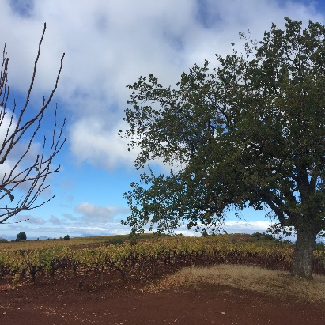
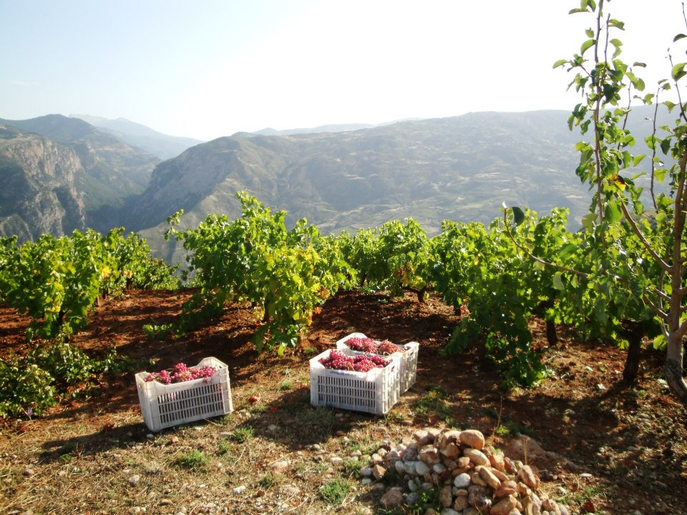
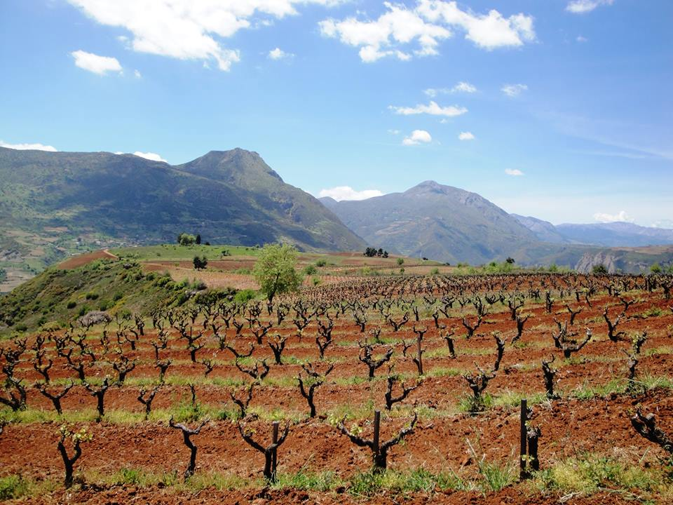
Presentation of Aigialia
.
The vine is cultivated on the slopes of Aigialia since the ancient times.
altitude 400-1000m.
north & north-eastern sun exposure
cool sea breeze of the Corinthian Gulf
exceptional climatic conditions
fertile and diverse soils
low yields

Slide 6
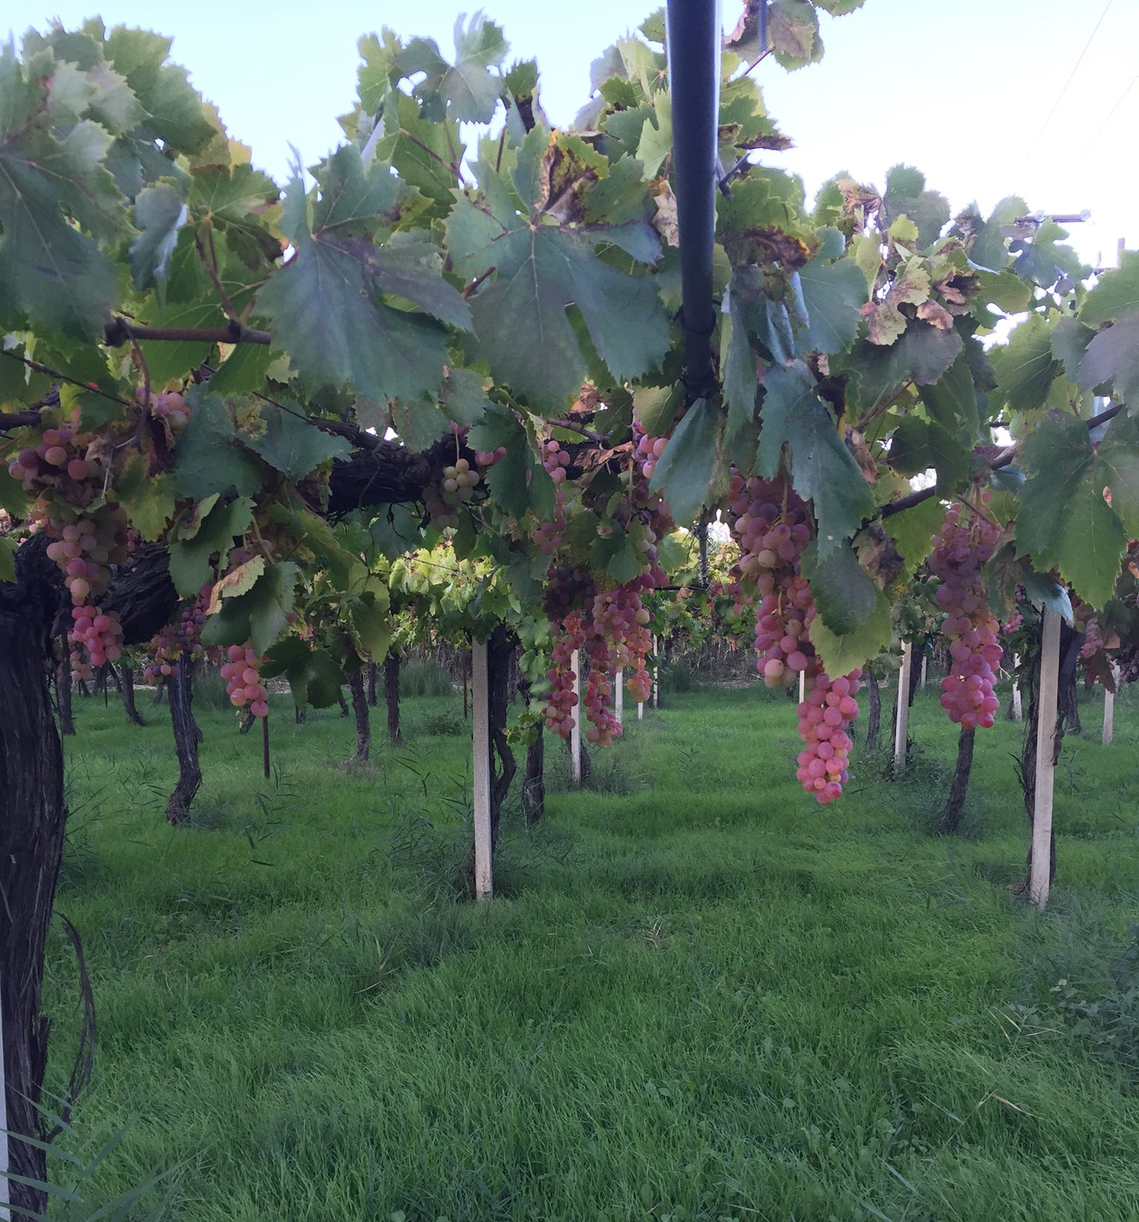
Our Varieties
We produce wines from indigenous Greek varieties from the PDO and PGI zones of Patra, Aigialia and Nemea to express the highest potential of
Mavrodaphne,
White Muscat,
Roditis,
Sideritis and
Agiorgitiko

Slide 7
Culture-Philosophy- Quality
vinification indigenous varieties of Aigialia Greece
highlighting the typical characteristics of each variety
special vinifications - unique products
excellent quality
authenticity

Slide 8
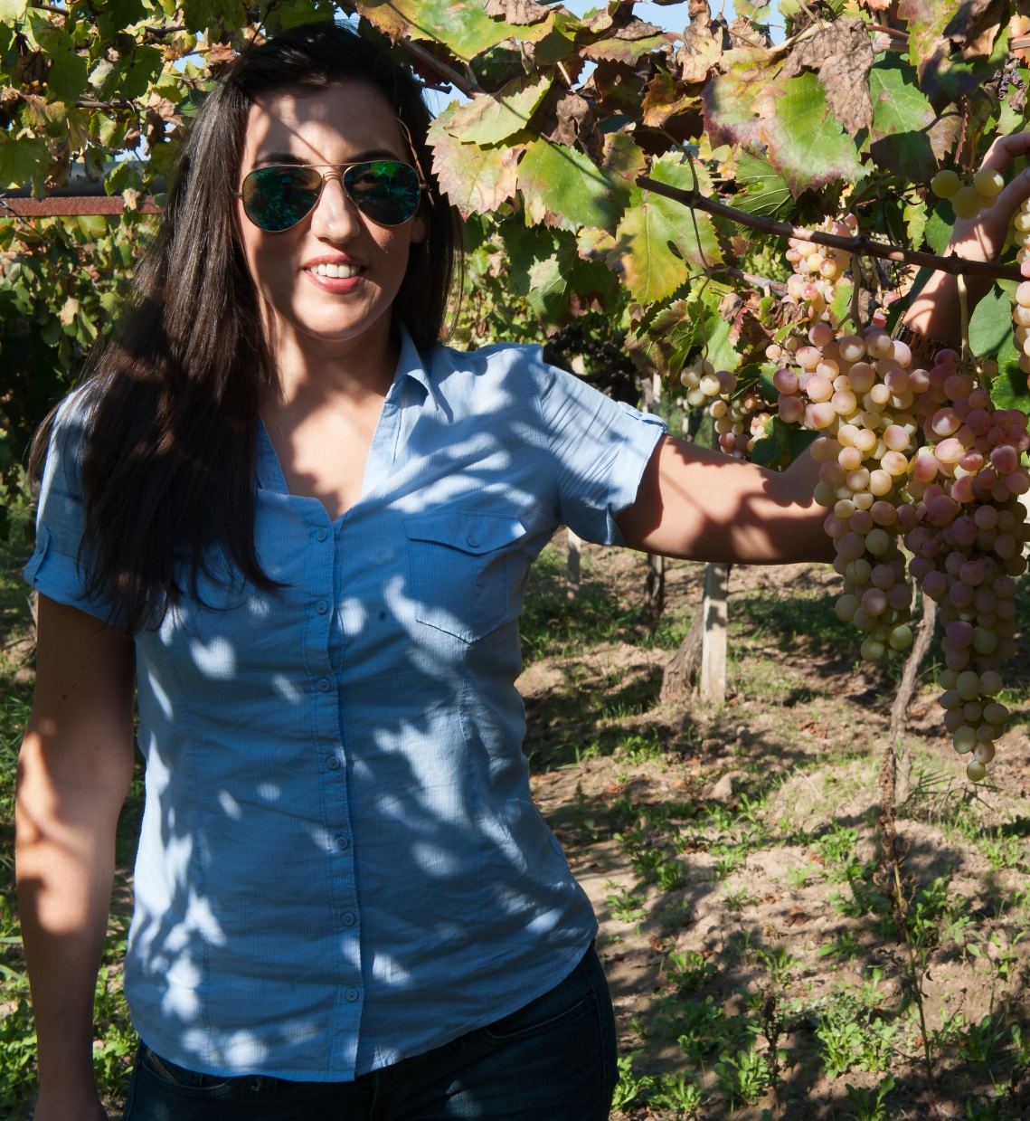
Our Vision
The production of world class wines highlighting the Greek indigenous varieties profile and the Aigialia terroir with respect to the man and the environment

Slide 9
Vineyard of Rodites
Organic vineyard, low yield plateau Mamousia Aigiou (altitude 850 m.).

Slide 12
Icon R
Orange yellow colour
Aromas of citrus fruit
Full on the palate
Crispy acidity
Minerality

Slide 13
Vineyard of Siderites
An indigenous variety of Achaia, now fast disappearing

Slide 14
I r o n
Late harvest
Low volume wines
Good acidity
Refreshig taste
Herby aromas

Slide 15
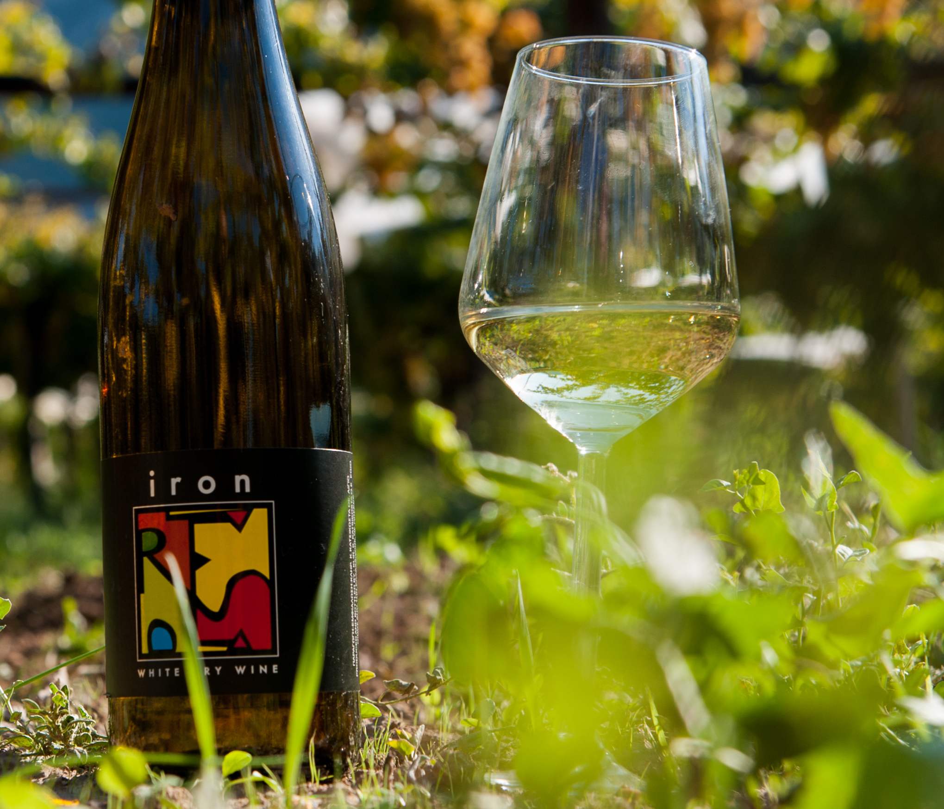
minerality
peach
citrus
grapefruit

Slide 16
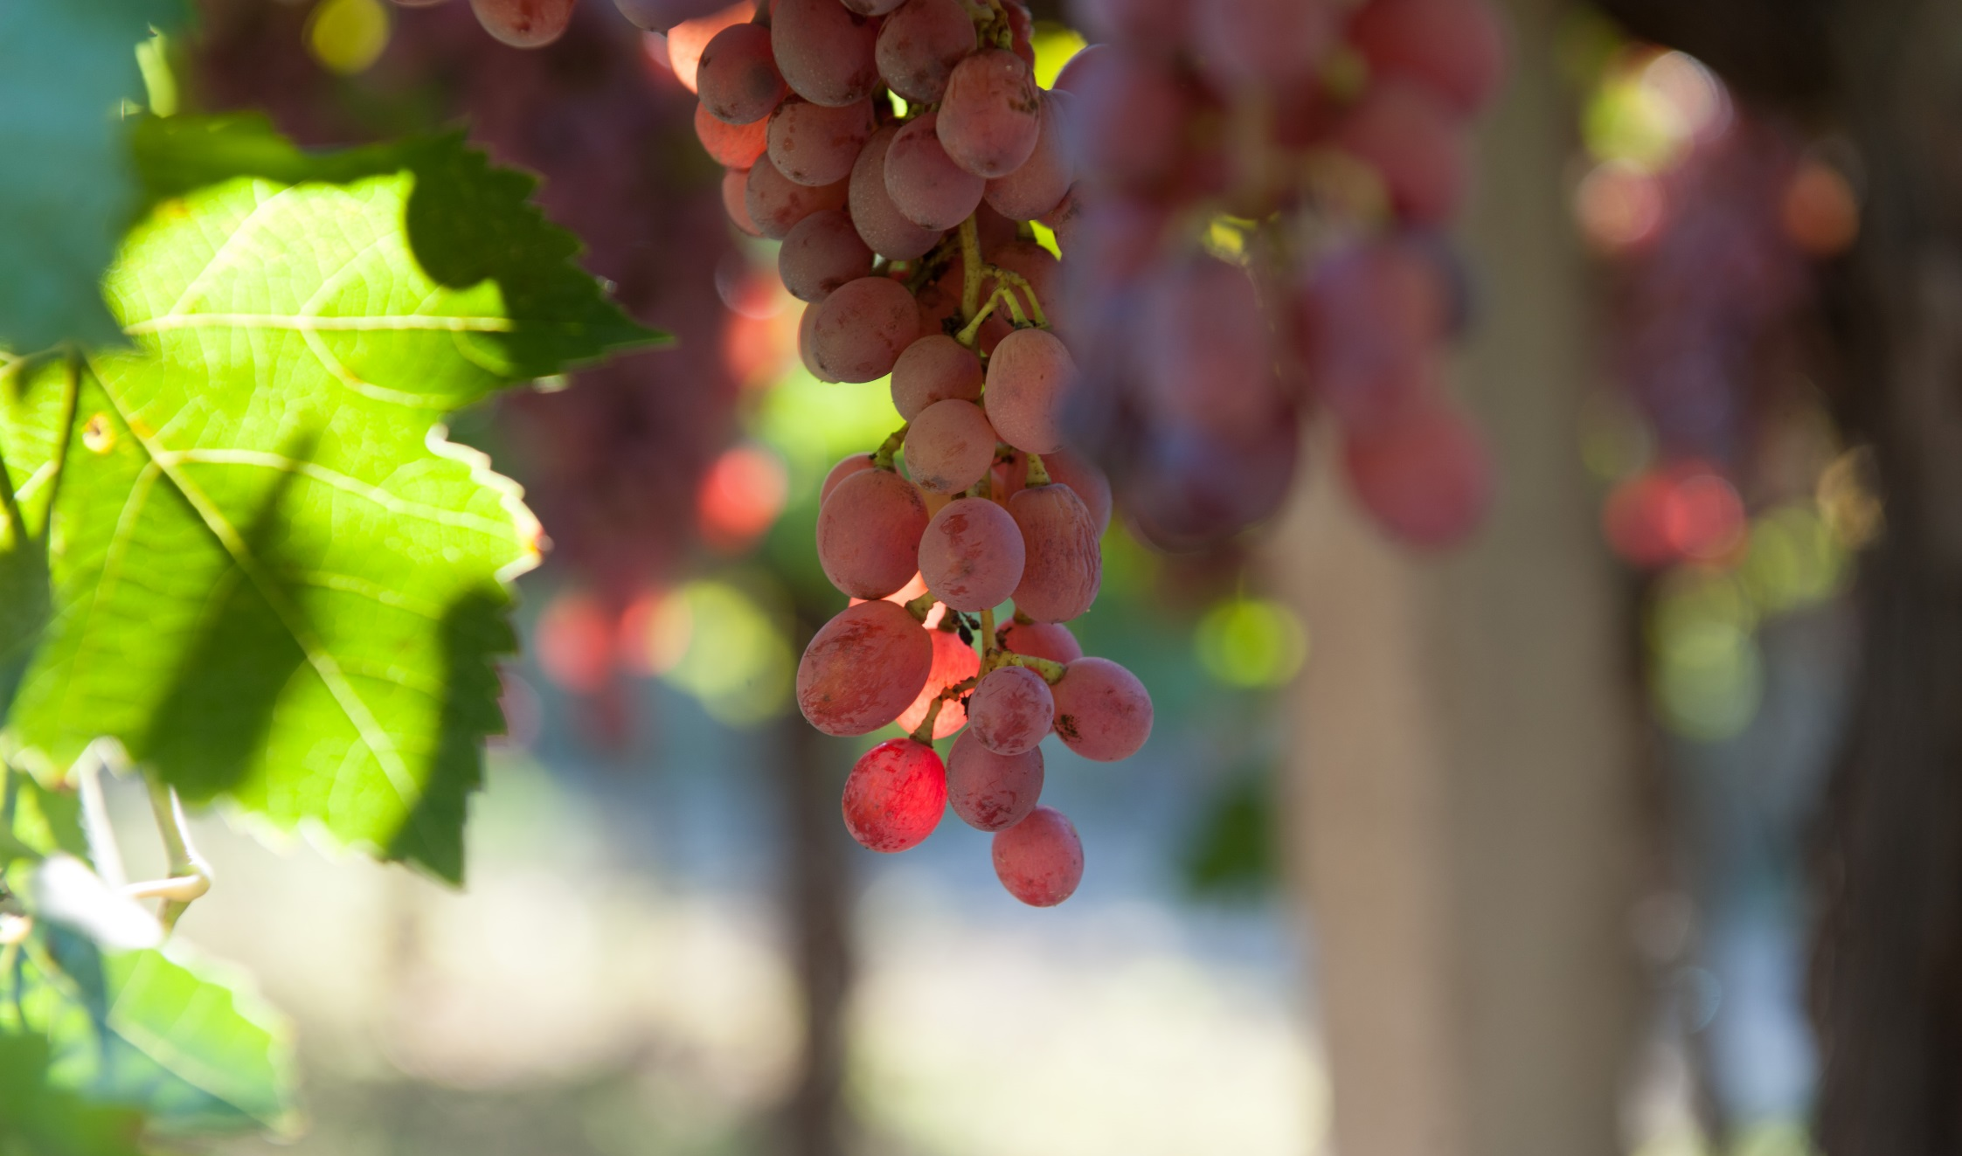

Slide 17
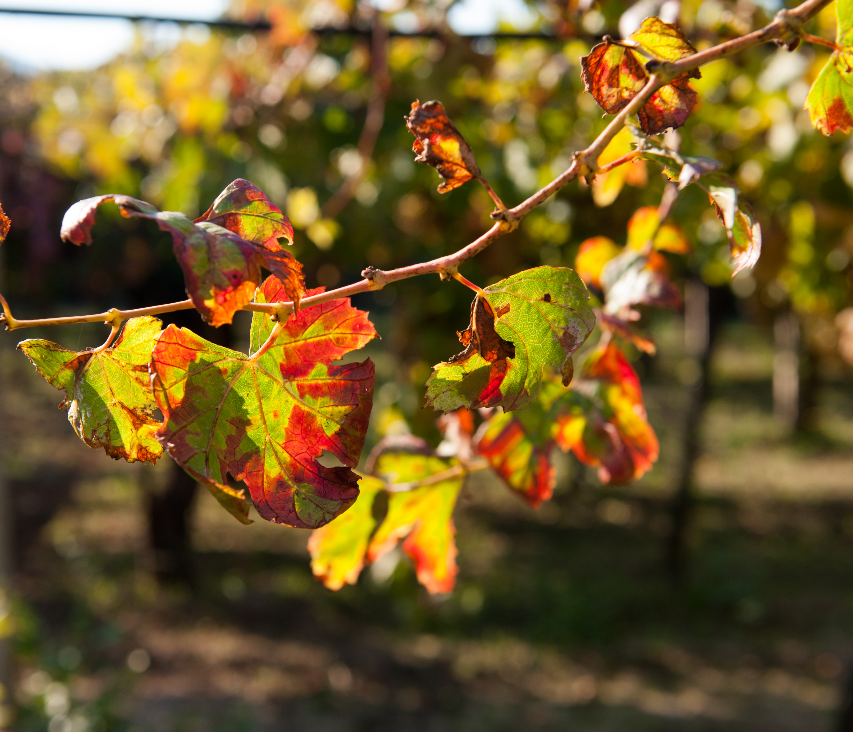

Slide 18
Vineyard of mavrodaphe
Unique wine fresh dry Mavrodaphne, altitude 450 m.

Slide 19
LAURA NERA
Fresh and dry
Deep red purple colour
Aromas of plum, sour cherry herbes, laurel leaves,fine spices
Soft on the palate
Delicate tanins

Slide 20
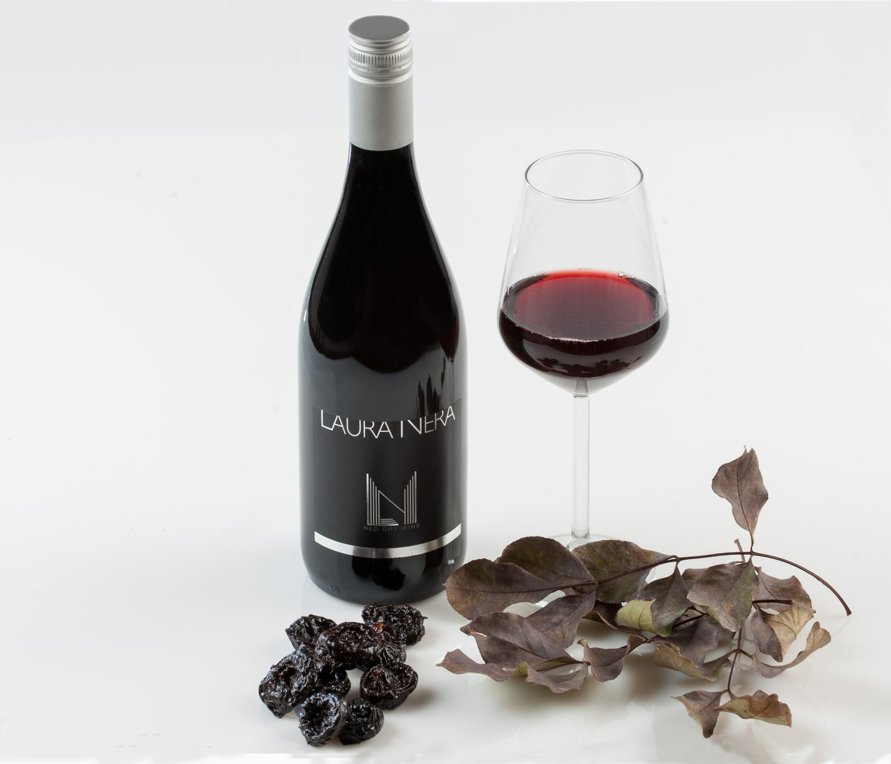
eucalyptus
plum
thyme
black cherry

Slide 21
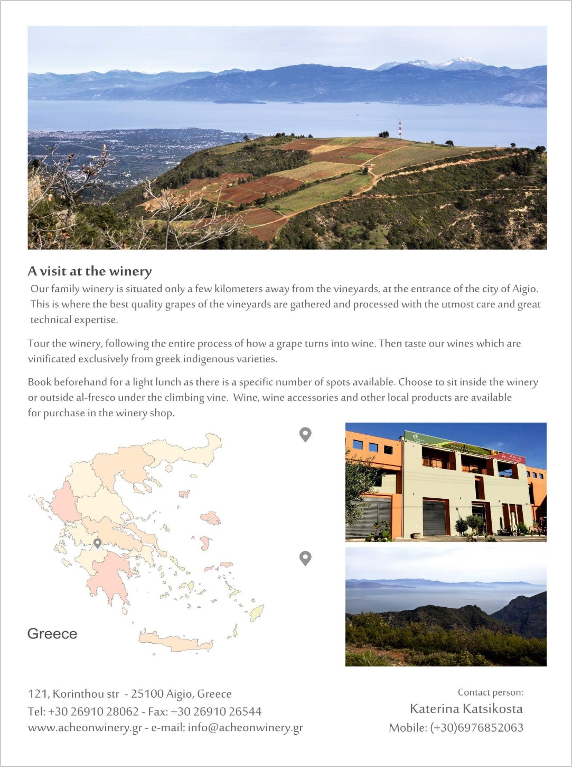
6. Wine Tourism

Slide 22
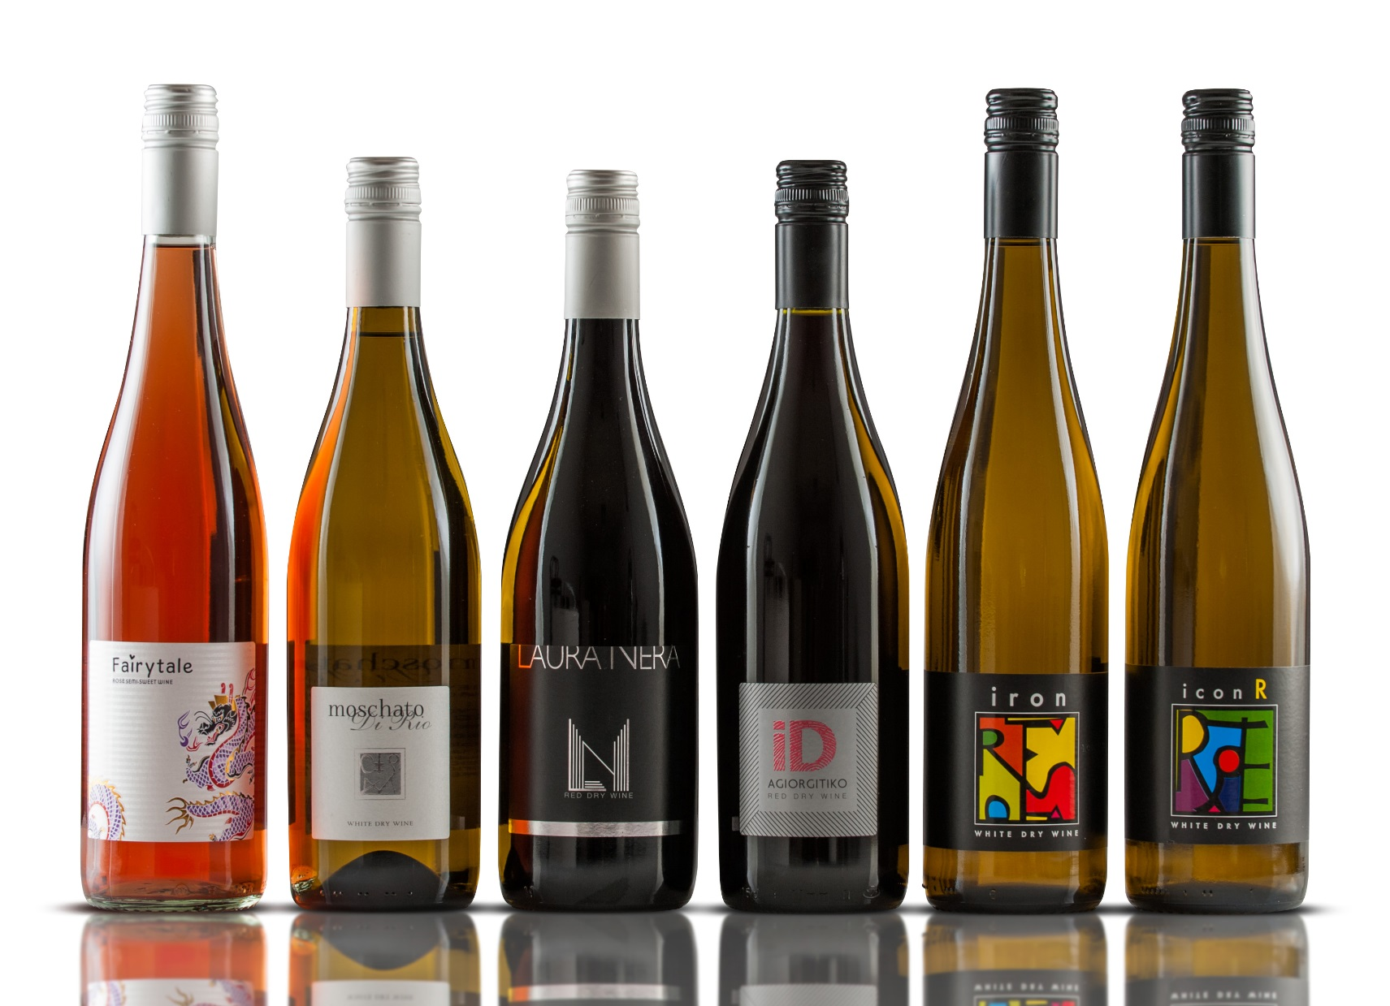

Slide 23
Thank You!
Postal address:
121 Korinthou av.
25100 Aigio, Greece
Tel..: + (30) 26910 28062
Fax: + (30) 26910 26544
Head of winery:
Sosanna Katsikosta, Oenologist
Mob. : (+30) 6983069926
e-mail: info@acheonwinery.gr
web site: www.acheonwinery.gr
Fb: www.facebook.com/ Αχαιών Οινοποιητική-Acheon Winery

